Slide 1

Memory management

Slide 2
Memory management
Memory management is the functionality of an operating system which handles or manages primary memory and moves processes back and forth between main memory and disk during execution.
Memory management keeps track of each and every memory location, regardless of either it is allocated to some process or it is free. It checks how much memory is to be allocated to processes. It decides which process will get memory at what time. It tracks whenever some memory gets freed or unallocated and correspondingly it updates the status.

Slide 3
What is Memory Management?
Memory Management is the process of controlling and coordinating computer memory, assigning portions known as blocks to various running programs to optimize the overall performance of the system.

Slide 4
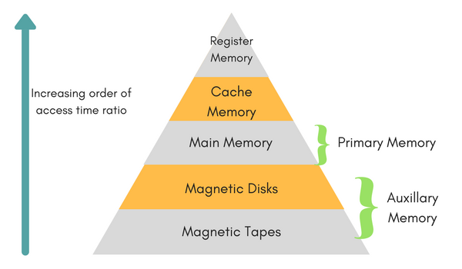
Memory Hierarchy

Slide 5
Memory Hierarchy
Registers are a type of computer memory used to quickly accept, store, and transfer data and instructions that are being used immediately by the CPU. The registers used by the CPU are often termed as Processor registers.
Cache Memory : Cache memory can also be found in the processor , it holds the chunk of data which are frequently used from main memory.
Main Memory :Main memory is the primary, internal workspace in the computer, commonly known as RAM (random access memory).

Slide 6
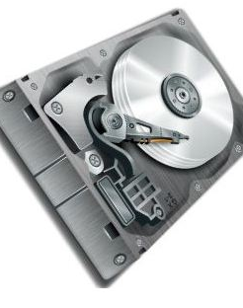
Memory Hierarchy
Magnetic Disks : A magnetic disk is a storage device that uses a magnetization process to write, rewrite and access data. It is covered with a magnetic coating and stores data in the form of tracks, spots and sectors. Hard disks, zip disks and floppy disks are common examples of magnetic disks.

Slide 7

Memory Hierarchy
Magnetic Tape :Magnetic tape is a medium for magnetic recording, made of a thin, magnetizable coating on a long, narrow strip of plastic film

Slide 8
Logical vs physical address space
Logical Address :
Address generated by CPU while a program is running is referred as Logical Address. The logical address is virtual as it does not exist physically. Hence, it is also called as Virtual Address.
Physical Address :
Physical Address identifies a physical location in a memory. MMU (Memory-Management Unit) computes the physical address for the corresponding logical address. MMU also uses logical address computing physical address.

Slide 9
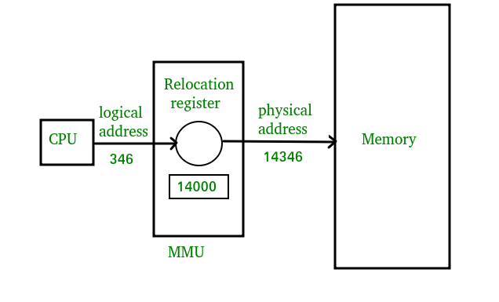

Slide 10
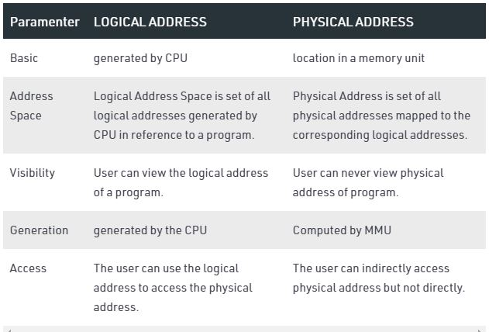

Slide 11
Static vs Dynamic Loading
The choice between Static or Dynamic Loading is to be made at the time of computer program being developed.
If you have to load your program statically, then at the time of compilation, the complete programs will be compiled and linked without leaving any external program or module dependency.
if you are writing a Dynamically loaded program, then your compiler will compile the program and for all the modules which you want to include dynamically, only references will be provided and rest of the work will be done at the time of execution.

Slide 12
Static vs Dynamic Linking
when static linking is used, the linker combines all other modules needed by a program into a single executable program to avoid any runtime dependency.
When dynamic linking is used, it is not required to link the actual module or library with the program, rather a reference to the dynamic module is provided at the time of compilation and linking. Dynamic Link Libraries (DLL) in Windows and Shared Objects in Unix are good examples of dynamic libraries.

Slide 13
Memory management with swapping
Swapping
Swapping is a mechanism in which a process can be swapped temporarily out of main memory (or move) to secondary storage (disk) and make that memory available to other processes. At some later time, the system swaps back the process from the secondary storage to main memory.

Slide 14
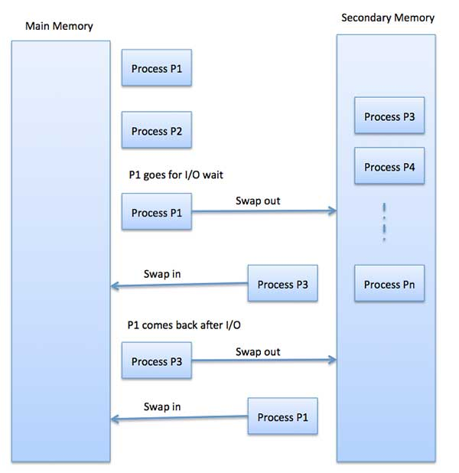
Memory management with swapping
Though performance is usually affected by swapping process but it helps in running multiple and big processes in parallel and that's the reason Swapping is also known as a technique for memory compaction.

Slide 15
Benefits of Swapping
It offers a higher degree of multiprogramming.
Allows dynamic relocation. For example, if address binding at execution time is being used, then processes can be swap in different locations. Else in case of compile and load time bindings, processes should be moved to the same location.
It helps to get better utilization of memory.
Minimum wastage of CPU time on completion so it can easily be applied to a priority-based scheduling method to improve its performance.

Slide 16
Memory management with Bitmaps
when memory is assigned dynamically , the OS must manage it.
in general there are two ways to keep track of memory usage.
memory management with bitmap.
memory management with linked list.

Slide 17
Memory management with Bitmaps
- Memory is divided into allocation units and each allocation unit has a bit in the bitmap. - If the bit is 0, the unit is free. - It requires less memory to store bit maps. - Searching a bitmap for a run of a given length is a slow operation.

Slide 18
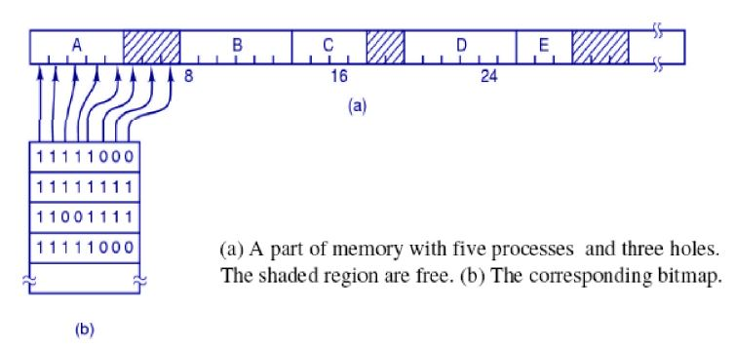
Memory management with Bitmaps

Slide 19
Memory management with Linked list
A linked list of allocated and free memory segments is maintained.
Each entry in a list specifies a hole or process, address at which it starts, length and pointer to next entry.
Process and hole are on a list sorted by address.

Slide 20
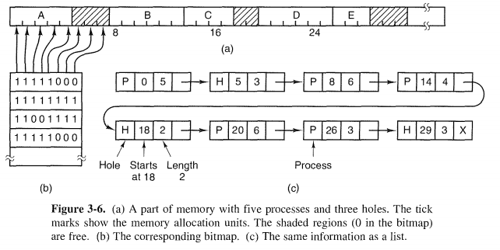
Memory management with Linked list

Slide 21
Memory management without swapping
In this mechanism Entire process remains in memory from start to finish and does not move.
The sum of the memory requirements of all jobs in the system cannot exceed the size of physical memory.
There are two models in this technique:
Mono-programming without swapping
Multiprogramming with fixed partitions

Slide 22
Mono-programming without swapping
In this scheme, it is allowed to run only one program at a time, sharing memory between program and OS.
When user provides command, the as copies requested program to memory form disk and executes it. As the program completes, the OS displays prompt character and waits for next command. When next command is provided, it beds new program into memory overwriting the previous program.

Slide 23
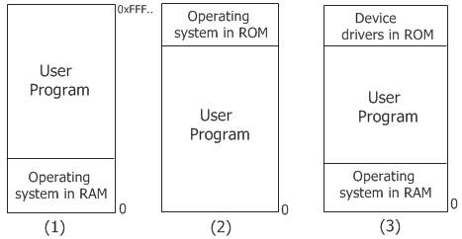
Mono-programming without swapping
The first model was used on very early computers.
The second model is used on some palmtop computers and embedded systems.
The third model is used by MS-DOS. The next command would load a new program into memory, overwriting the previous one.

Slide 24
Memory Allocation Techniques
Contiguous Storage Allocation
Fixed Partition Allocation
Variable Partition Allocation
Non-Contiguous
Paging
Segmentation

Slide 25
Multiprogramming with Fixed Partition
Multiprogramming increases CPU utilization by allowing multiple processes in memory at once so that when one process is blocked, another process can be use the CPU.
It can be achieved by dividing memory into ‘n’ partitions.
When any process requests memory, it can be put into input queue for the smallest partition large enough to hold it.
Any space in a partition which are not used by a process are wasted.
It can also be done by maintaining a single queue.

Slide 26
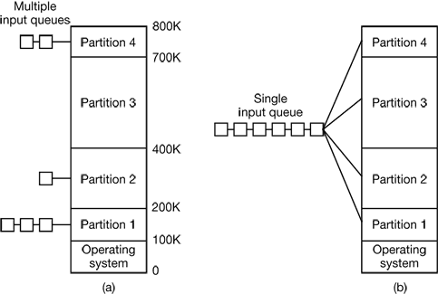

Slide 27
Advantages and disadvantages of fixed partition
Advantages:
Easy to implement.
Little OS overhead : needs indirect processing power.
Disadvantages
Internal Fragmentation : same amount of memory portioned.
Limitation on degree of Multiprogramming
Limit process Size : process cannot run sufficiently.

Slide 28
Multiprogramming with Variable Partition
The memory is partitioned dynamically when process comes and goes.
The number, location and size of partitions vary.
Swapping can crate multiple holes in memory and it can be combined into one big hole by moving all processes download. This is called memory compaction. (coalescing )adjacent hole.
memory compaction requires a lot of CPU time

Slide 29
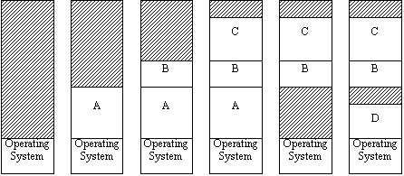
Multiprogramming with Variable Partition

Slide 30
Advantages and disadvantages of variable partition
Advantages
No internal fragmentation
No restriction on degree of multiprogramming
No limitation on the size of process
Disadvantages
Difficult to implement
Need external fragmantation of memory if space is unavailable in main memory.

Slide 31
Problems with Multiprogramming:
1) Relocation: It is the method of shifting a user program frame line memory location to another. To achieve relocation, it can be equipped with address of the start of its partition and limit register is loaded with length of partition
2) protection: When absolute memory address is used, a malicious program can read or write any ward in memory.

Slide 32
Relocation and Protection
Protection : Once you can have two programs in memory at the same time there is a danger that one program can write to the address space of another program. This is obviously dangerous and should be avoided.
Relocation : When a program is run it does not know in advance what location it will be loaded at. Therefore, the program cannot simply generate static addresses (e.g. from jump instructions). Instead, they must be made relative to where the program has been loaded.

Slide 33
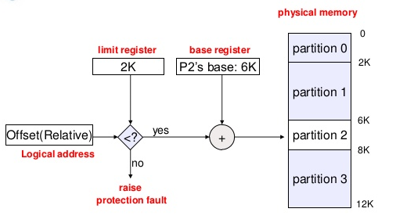

Slide 34
Fragmentation
Fragmentation is an unwanted problem where the memory blocks cannot be allocated to the processes due to their small size and the blocks remain unused.
It can also be understood as when the processes are loaded and removed from the memory they create free space or hole in the memory and these small blocks cannot be allocated to new upcoming processes and results in inefficient use of memory.
Basically, there are two types of fragmentation:
Internal Fragmentation
External Fragmentation

Slide 35

Internal Fragmentation
In this fragmentation, the process is allocated a memory block of size more than the size of that process. Due to this some part of the memory is left unused and this cause internal fragmentation.

Slide 36
Internal Fragmentation
Example: Suppose there is fixed partitioning (i.e. the memory blocks are of fixed sizes) is used for memory allocation in RAM. These sizes are 2MB, 4MB, 4MB, 8MB. Some part of this RAM is occupied by the Operating System (OS).
Now, suppose a process P1 of size 3MB comes and it gets memory block of size 4MB. So, the 1MB that is free in this block is wasted and this space can’t be utilized for allocating memory to some other process. This is called internal fragmentation.

Slide 37
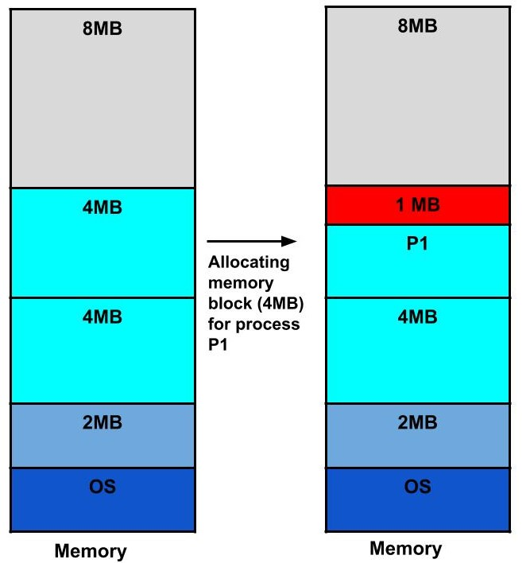
Internal Fragmentation

Slide 38

How to remove internal fragmentation?
This problem is occurring because we have fixed the sizes of the memory blocks. This problem can be removed if we use dynamic partitioning for allocating space to the process. In dynamic partitioning, the process is allocated only that much amount of space which is required by the process. So, there is no internal fragmentation.

Slide 39

External Fragmentation
In this fragmentation, although we have total space available that is needed by a process still we are not able to put that process in the memory because that space is not contiguous. This is called external fragmentation.

Slide 40
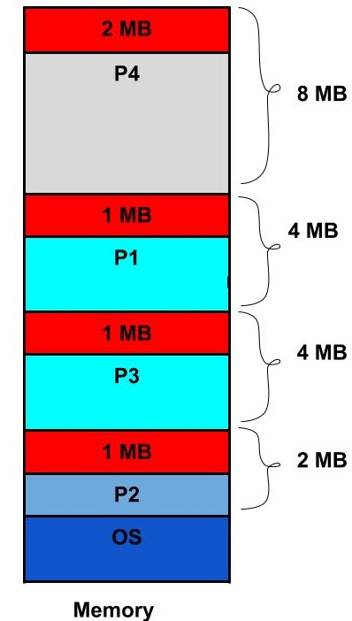
External Fragmentation
Example: Suppose in the above example, if three new processes P2, P3, and P4 come of sizes 2MB, 3MB, and 6MB respectively. Now, these processes get memory blocks of size 2MB, 4MB and 8MB respectively allocated.
So, now if we closely analyze this situation then process P3 (unused 1MB)and P4(unused 2MB) are again causing internal fragmentation. So, a total of 4MB (1MB (due to process P1) + 1MB (due to process P3) + 2MB (due to process P4)) is unused due to internal fragmentation.
Now, suppose a new process of 4 MB comes. Though we have a total space of 4MB still we can’t allocate this memory to the process. This is called external fragmentation.

Slide 41

How to remove external fragmentation?
This problem is occurring because we are allocating memory continuously to the processes. So, if we remove this condition external fragmentation can be reduced. This is what done in paging & segmentation(non-contiguous memory allocation techniques) where memory is allocated non-contiguously to the processes. We will learn about paging and segmentation in the next blog.

Slide 42

Memory Allocation strategies
Memory allocation is the process of assigning blocks of memory on request.
Typically the allocator receives memory from OS in a small blocks that it must divide up to satisfy the requests for smaller blocks.
Several algorithms are used to allocate the memory for newly created process.

Slide 43
Memory Allocation strategies
The popular strategies of memory allocation for newly created processes by using linked list are :
First Fit
Next Fit
Best Fit
Worst Fit
Quick Fit

Slide 44
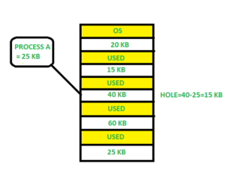
First Fit
In the first fit, the partition is allocated which is the first sufficient block from the top of Main Memory. It scans memory from the beginning and chooses the first available block that is large enough. Thus it allocates the first hole that is large enough.

Slide 45
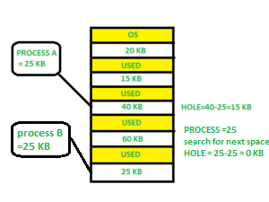
Next Fit
Next fit is similar to the first fit but it will search for the first sufficient partition from the last allocation point.

Slide 46
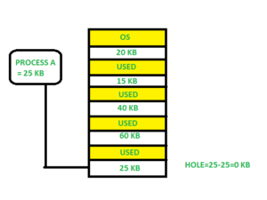
Best Fit
Allocate the process to the partition which is the first smallest sufficient partition among the free available partition. It searches the entire list of holes to find the smallest hole whose size is greater than or equal to the size of the process.

Slide 47
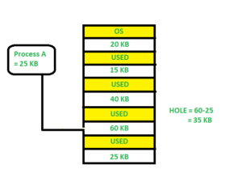
Worst Fit
Allocate the process to the partition which is the largest sufficient among the freely available partitions available in the main memory. It is opposite to the best-fit algorithm. It searches the entire list of holes to find the largest hole and allocate it to process.

Slide 48

Quick Fit
The quick fit algorithm suggests maintaining the different lists of frequently used sizes. Although, it is not practically suggestible because the procedure takes so much time to create the different lists and then expending the holes to load a process.

Slide 49

Which one is Best Algorithm??
The first fit algorithm is the best algorithm among all because
It takes lesser time compare to the other algorithms.
It produces bigger holes that can be used to load other processes later on.
It is easiest to implement.

Slide 50
Exercise: Consider the requests from processes in given order 300K, 25K, 125K, and 50K. Let there be two blocks of memory available of size 150K followed by a block size 350K.
Best Fit: 300K is allocated from a block of size 350K. 50 is left in the block. 25K is allocated from the remaining 50K block. 25K is left in the block. 125K is allocated from 150 K block. 25K is left in this block also. 50K can’t be allocated even if there is 25K + 25K space available.
First Fit: 300K request is allocated from 350K block, 50K is left out. 25K is be allocated from the 150K block, 125K is left out. Then 125K and 50K are allocated to the remaining left out partitions. So, the first fit can handle requests.
So option B is the correct choice.

Slide 51
Assignment:
What is memory allocation? Explain the difference between Contiguous and Non-contiguous Memory Allocation.
Ans: https://www.includehelp.com/operating-systems/contiguous-and-non-contiguous-memory-allocation.aspx

Slide 52
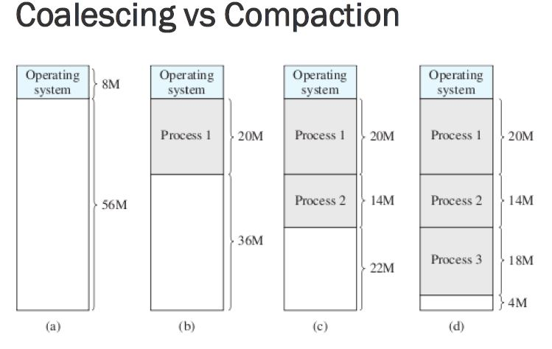

Slide 53
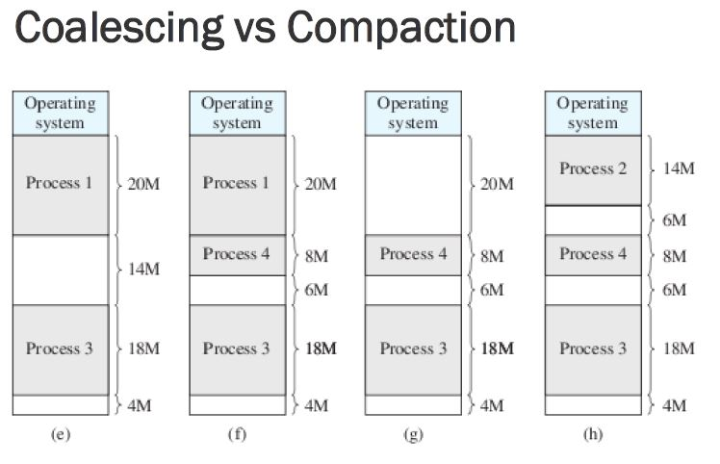

Slide 54
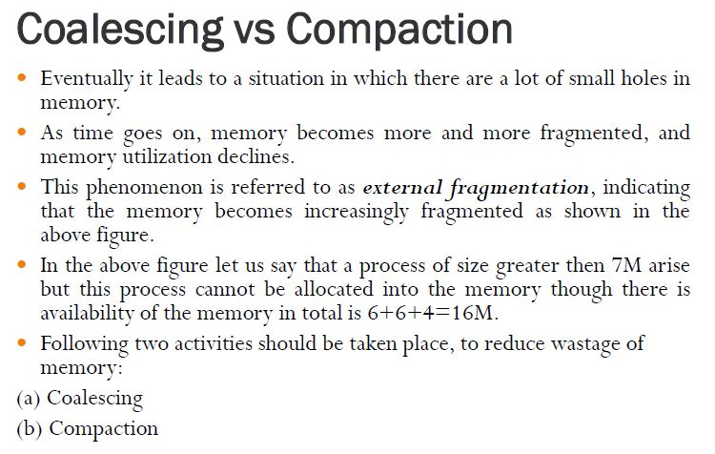

Slide 55
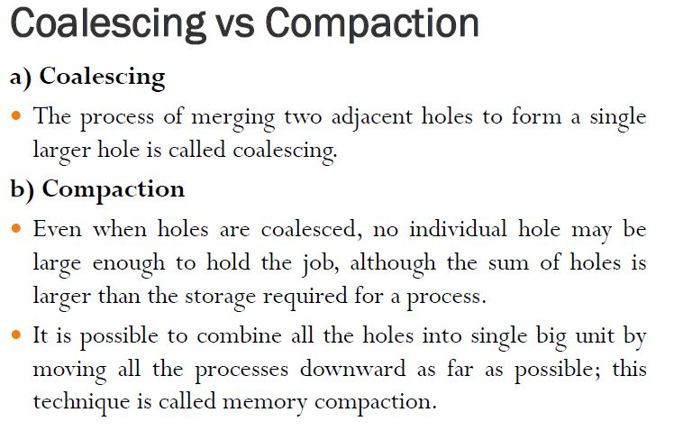

Slide 56
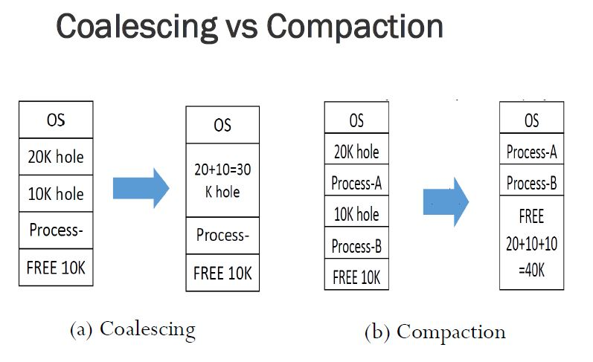

Slide 57
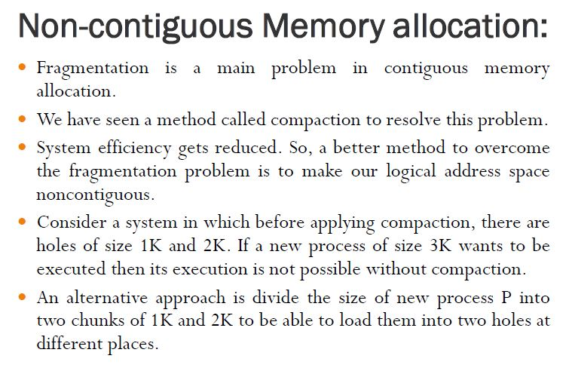

Slide 58
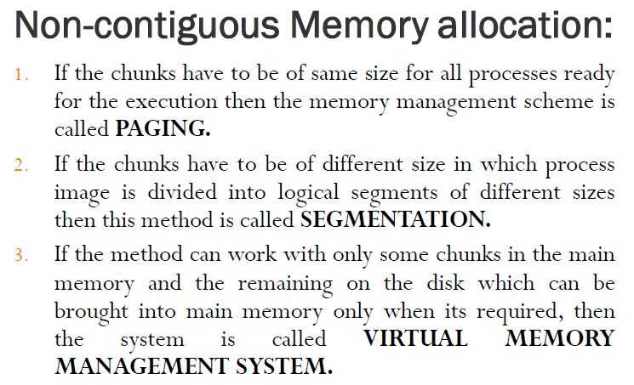

Slide 59

Thank you

